Slide 1
wedding photo booth rental
https://sites.google.com/view/light-tunnel-vogue-photo-booth/home
Notes:
https://drive.google.com/file/d/1yQ0lpIQExJCIpuGiATWJ32yIWQ-IIzPQ/view?usp=sharing
https://drive.google.com/file/d/1Gl6nwc7N9z2WpcthQO6Ja8TnMTWDpraX/view?usp=sharing
https://drive.google.com/file/d/1NzTij0XAdJqDgrQz5VMAPqacp4XHEYEV/view?usp=sharing
https://docs.google.com/document/d/1g889hshP0-nyq3LIOmpiz268GSVdLXtV9jeTBEM5LyE/edit?usp=sharing
https://docs.google.com/document/d/1g889hshP0-nyq3LIOmpiz268GSVdLXtV9jeTBEM5LyE/pub
https://docs.google.com/document/d/1g889hshP0-nyq3LIOmpiz268GSVdLXtV9jeTBEM5LyE/view
https://docs.google.com/presentation/d/1b4ZC-n94NoolxlD6_trKhft0fTRiyTw_yE-aZdwu3PM/edit?usp=sharing
https://docs.google.com/presentation/d/1b4ZC-n94NoolxlD6_trKhft0fTRiyTw_yE-aZdwu3PM/pub?start=true&loop=true&delayms=3000
https://docs.google.com/presentation/d/1b4ZC-n94NoolxlD6_trKhft0fTRiyTw_yE-aZdwu3PM/view
https://docs.google.com/presentation/d/1b4ZC-n94NoolxlD6_trKhft0fTRiyTw_yE-aZdwu3PM/htmlpresent
https://docs.google.com/document/d/1WqkMI9fQYLS89TCsmjOVjKwvhIBd4zFAmDviqiu4CwQ/edit?usp=sharing
https://docs.google.com/document/d/1WqkMI9fQYLS89TCsmjOVjKwvhIBd4zFAmDviqiu4CwQ/pub
https://docs.google.com/document/d/1WqkMI9fQYLS89TCsmjOVjKwvhIBd4zFAmDviqiu4CwQ/view
https://docs.google.com/presentation/d/10JE4d_TUf1-6xauan4hqWVehY5K6zpXBrJwLFVlNf0k/edit?usp=sharing
https://docs.google.com/presentation/d/10JE4d_TUf1-6xauan4hqWVehY5K6zpXBrJwLFVlNf0k/pub?start=true&loop=true&delayms=3000
https://docs.google.com/presentation/d/10JE4d_TUf1-6xauan4hqWVehY5K6zpXBrJwLFVlNf0k/view
https://docs.google.com/presentation/d/10JE4d_TUf1-6xauan4hqWVehY5K6zpXBrJwLFVlNf0k/htmlpresent

Slide 2
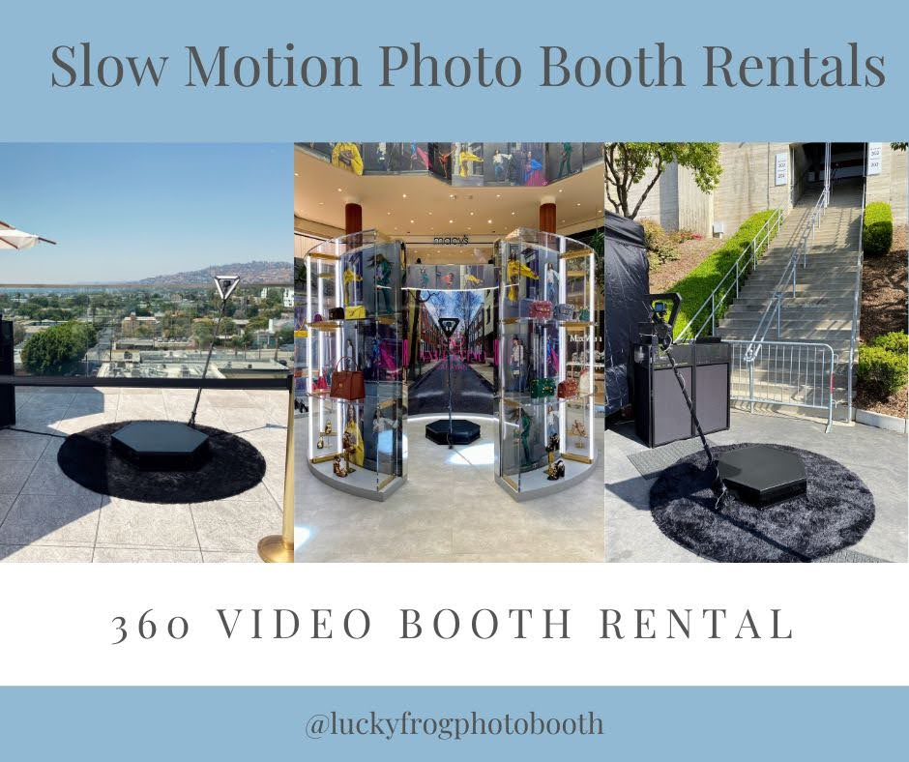

Slide 4
wedding photo booth rental
Furthermore, digital photo booths frequently include all-inclusive packages as well as customized choices such as custom backdrops and photo layouts, allowing you to provide your guests with a one-of-a-kind and personalized experience. A digital photo booth also gives your guests a one-of-a-kind and unforgettable experience.&nbsp;The interactive features and adjustable possibilities of a digital photo booth make it a fun and exciting addition to any event. To create a really remarkable experience, guests may take images, tweak them with interesting filters and effects, and share them on social media. In conclusion, digital photo booths are becoming increasingly popular because of their superior technology, ease and flexibility, low cost, and unique and unforgettable experiences. Kim Kardashian looks lovely in her photo booth photos, her skin flawless and her clean white background evoking elegance. The essentials to generating the most spectacular images are superb lighting, decent equipment, a skilled crew, and, of course, their beauty.&nbsp;&nbsp;Furthermore, expert skins, smoothing, and filters work their magic to transform and improve every image. However, the situation is changing. A beautiful photo booth may be the answer if you also want to shoot celebrity-style images.&nbsp;Services that only superstars can afford are now available to ordinary folks like you and me. Add a gorgeous Kardashian-style photo booth to your event with an all-new premium service. Kim K-style images are no longer a distant memory. Take part in the magic. Get a close look at the enchantment. Every party requires a gorgeous photo booth for the ultimate Kardashian-style picture experience. When you want to add some Hollywood magic to your event, this is the ideal complement. Your visitors will be delighted for weeks by a picture booth. Our elegant photo booth will bring any occasion to life, whether it's a wedding, birthday, holiday party, business meeting, or coming-of-age ceremony. You may show off your professional-quality images and gain celebrity status. Rent it for your next event and add a new twist to the standard photo booth. How does a luxurious Kardashian-style photo booth work? Selected service providers install kiosks with high-quality backdrops on flat surfaces.&nbsp;You also require outlets and clear paths. When you and your guests enter the photobooth, the luxurious fun begins. The final image is smoothed with skin smoothing filters from a Hollywood studio. With the press of a button, you may download photographs or opt to get a digital co.
https://sites.google.com/view/light-tunnel-vogue-photo-booth/home
Notes:
selfie booth,wedding photo booth rental, mirror booth

Slide 5
Contact Information
Photo Fiesta! Photo Booth Rentals
16000 Kaplan Ave, City of Industry, CA 91744
562-303-9926
Notes:
Photo Fiesta! Photo Booth Rentals16000 Kaplan Ave, City of Industry, CA 91744562-303-9926

Slide 6
More info about us:
selfie booth
wedding photo booth rental
mirror booth
Notes:
Photo Fiesta! Photo Booth Rentals16000 Kaplan Ave, City of Industry, CA 91744562-303-9926

Slide 7
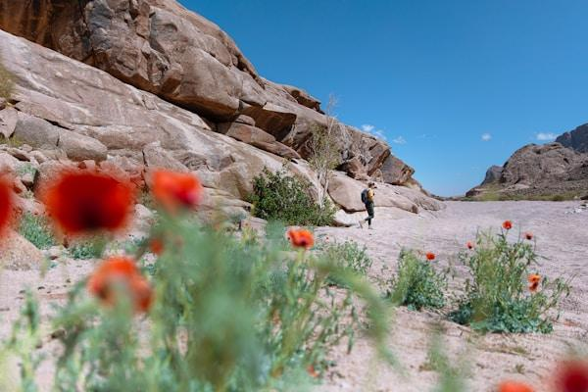

Slide 8
Links
List of recommended resources
Notes:
selfie booth,wedding photo booth rental, mirror booth

Slide 9
Please visit :
photo
photo
photo
document
document pub
document view
presentation
presentation pub
presentation view
presentation html
document
document pub
document view
presentation
presentation pub
presentation view
presentation html
Notes:
https://drive.google.com/file/d/1yQ0lpIQExJCIpuGiATWJ32yIWQ-IIzPQ/view?usp=sharing
https://drive.google.com/file/d/1Gl6nwc7N9z2WpcthQO6Ja8TnMTWDpraX/view?usp=sharing
https://drive.google.com/file/d/1NzTij0XAdJqDgrQz5VMAPqacp4XHEYEV/view?usp=sharing
https://docs.google.com/document/d/1g889hshP0-nyq3LIOmpiz268GSVdLXtV9jeTBEM5LyE/edit?usp=sharing
https://docs.google.com/document/d/1g889hshP0-nyq3LIOmpiz268GSVdLXtV9jeTBEM5LyE/pub
https://docs.google.com/document/d/1g889hshP0-nyq3LIOmpiz268GSVdLXtV9jeTBEM5LyE/view
https://docs.google.com/presentation/d/1b4ZC-n94NoolxlD6_trKhft0fTRiyTw_yE-aZdwu3PM/edit?usp=sharing
https://docs.google.com/presentation/d/1b4ZC-n94NoolxlD6_trKhft0fTRiyTw_yE-aZdwu3PM/pub?start=true&loop=true&delayms=3000
https://docs.google.com/presentation/d/1b4ZC-n94NoolxlD6_trKhft0fTRiyTw_yE-aZdwu3PM/view
https://docs.google.com/presentation/d/1b4ZC-n94NoolxlD6_trKhft0fTRiyTw_yE-aZdwu3PM/htmlpresent
https://docs.google.com/document/d/1WqkMI9fQYLS89TCsmjOVjKwvhIBd4zFAmDviqiu4CwQ/edit?usp=sharing
https://docs.google.com/document/d/1WqkMI9fQYLS89TCsmjOVjKwvhIBd4zFAmDviqiu4CwQ/pub
https://docs.google.com/document/d/1WqkMI9fQYLS89TCsmjOVjKwvhIBd4zFAmDviqiu4CwQ/view
https://docs.google.com/presentation/d/10JE4d_TUf1-6xauan4hqWVehY5K6zpXBrJwLFVlNf0k/edit?usp=sharing
https://docs.google.com/presentation/d/10JE4d_TUf1-6xauan4hqWVehY5K6zpXBrJwLFVlNf0k/pub?start=true&loop=true&delayms=3000
https://docs.google.com/presentation/d/10JE4d_TUf1-6xauan4hqWVehY5K6zpXBrJwLFVlNf0k/view
https://docs.google.com/presentation/d/10JE4d_TUf1-6xauan4hqWVehY5K6zpXBrJwLFVlNf0k/htmlpresent

Slide 10
wedding photo booth rental
https://sites.google.com/view/light-tunnel-vogue-photo-booth/home
Notes:
selfie booth,wedding photo booth rental, mirror booth

